Slide 1
Protonated Anthracene Update

Slide 2
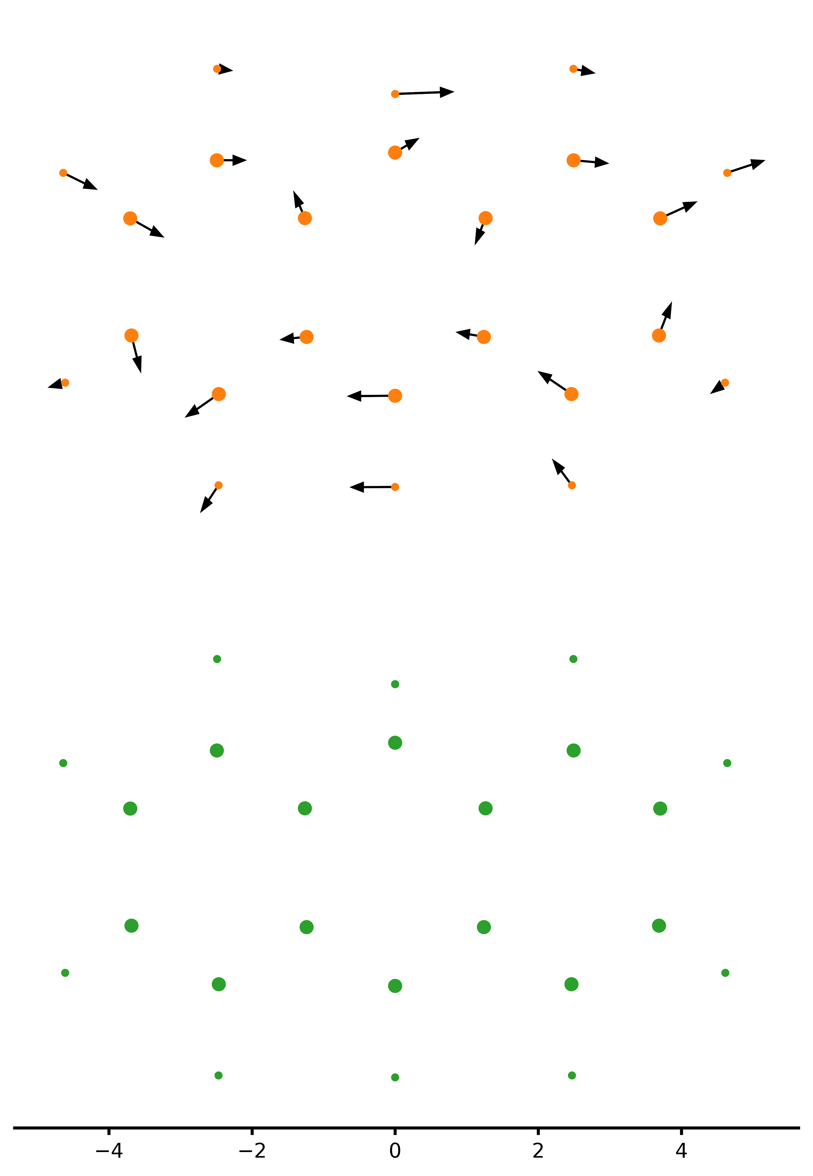
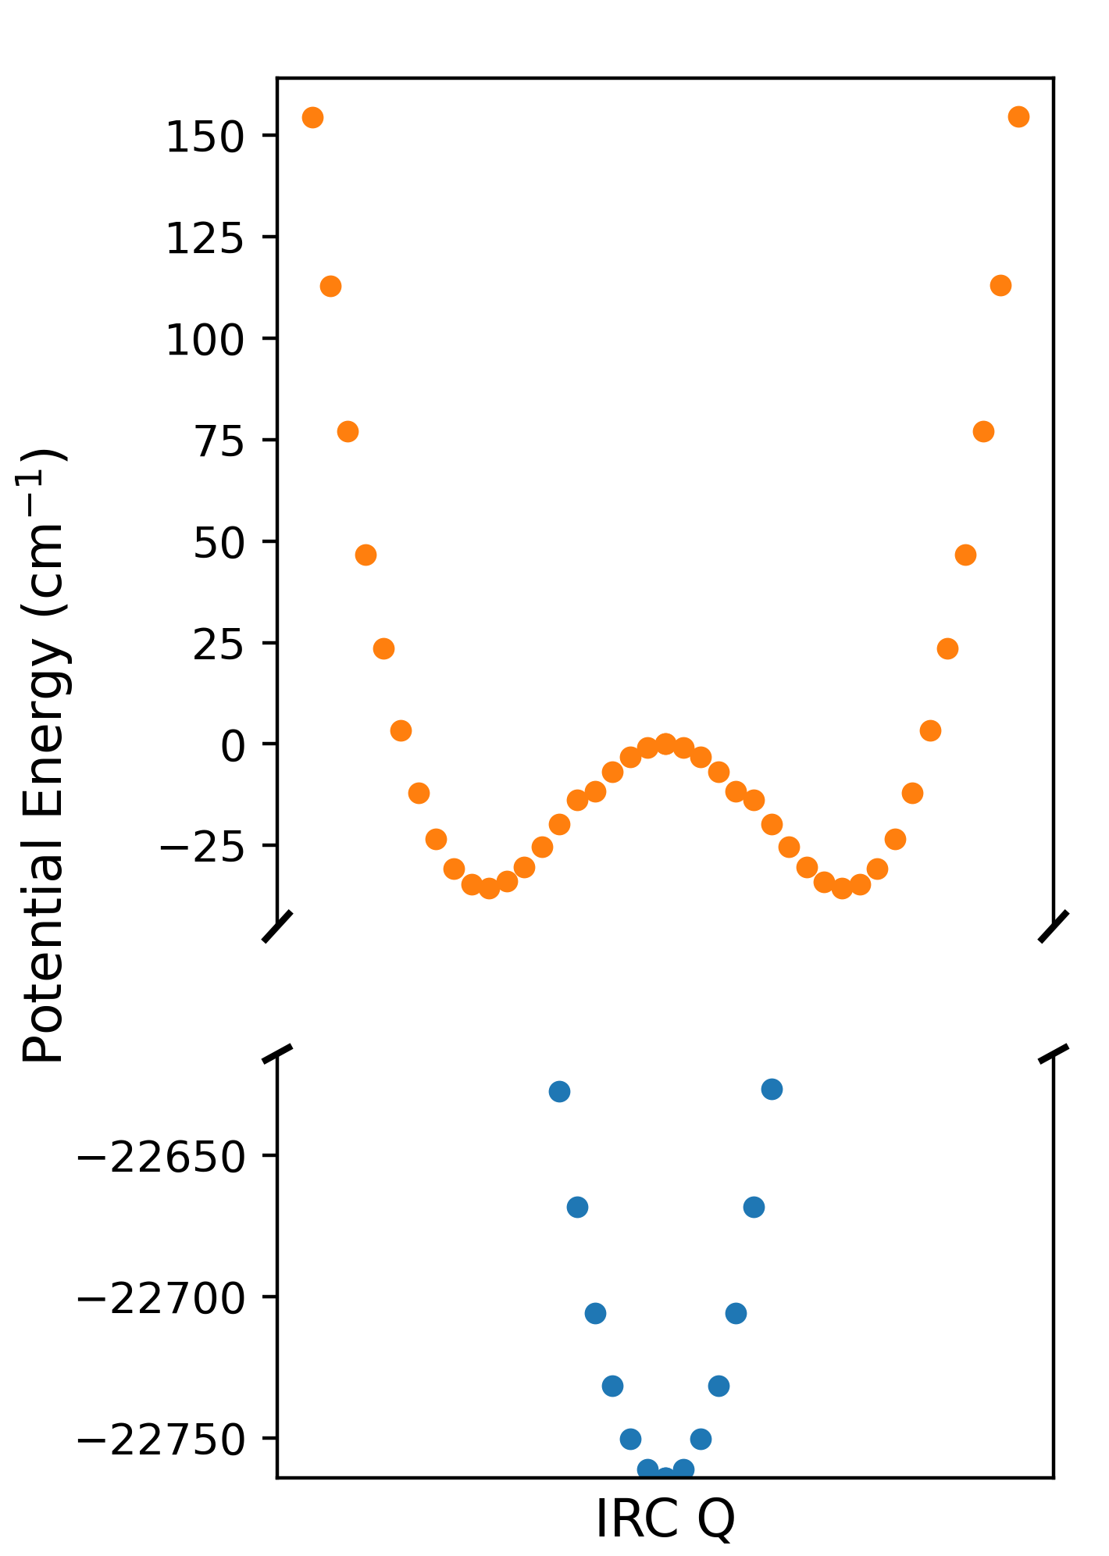
Protonated Anthracene Update
IRC Calculation from TS
M06-2X/cc-pvtz with GD3 correction
Planar C2v Transition State Geometry
(Arrows show the IRC Qn vectors)
Barrier Height ~35 cm-1
Planar Csv First Excited State Geometry
VDE ~ 22,765 cm-1
Slight ring distortion to Cs symmetry via b2 motion

Slide 3
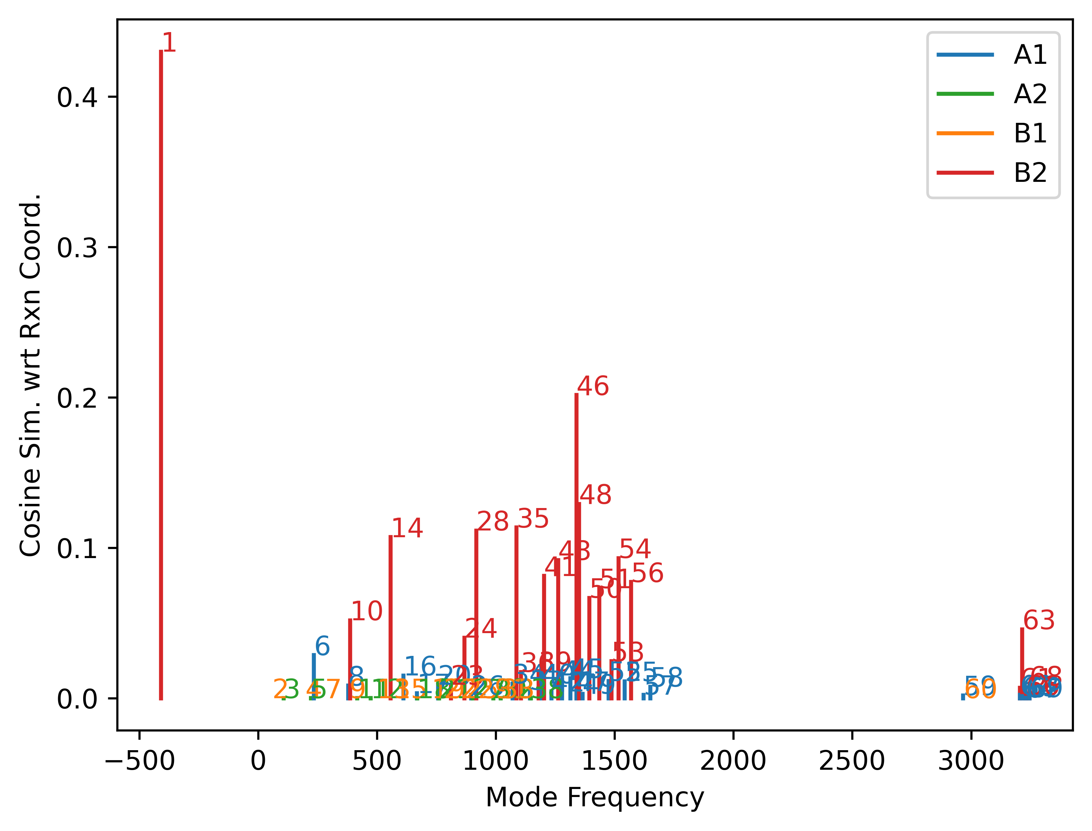
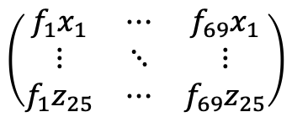
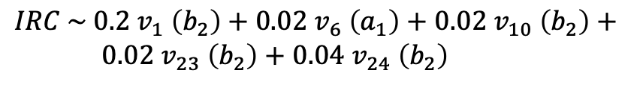

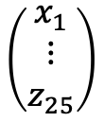
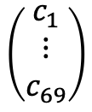
Protonated Anthracene Update
Cosine Similarity Measurements
Describing IRC Qn as a linear combination of normal modes
$$\left(\begin{matrix}f_{1}x_{1} & ⋯ & f_{69}x_{1} \\ ⋮ & ⋱ & ⋮ \\ f_{1}z_{25} & ⋯ & f_{69}z_{25}\end{matrix}\right)$$
$$\left(\begin{matrix}c_{1} \\ ⋮ \\ c_{69}\end{matrix}\right)$$
$$\left(\begin{matrix}x_{1} \\ ⋮ \\ z_{25}\end{matrix}\right)$$
$$=$$
$IRC \sim 0.2 v_{1} \left(b_{2}\right)+0.02 v_{6} \left(a_{1}\right)+$ $0.02 v_{10} \left(b_{2}\right)+$ $0.02 v_{23} \left(b_{2}\right)+$ $0.04 v_{24} \left(b_{2}\right)$
This gives an indication as to what modes may be involved with the hole transfer/spectrum
Measured the cosine similarity between the IRC coordinates and each of the 69 normal mode coordinates of the transition state, as a measure of which vibrational frequencies are in the ‘same direction’ as the rxn coord. Confirms that the distortion is through b2 vibrations

Slide 4
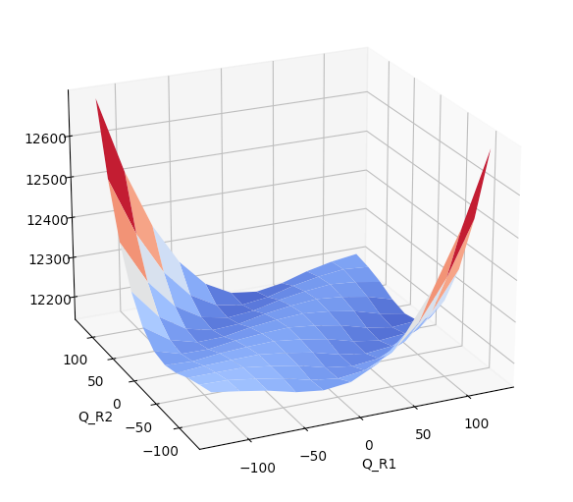
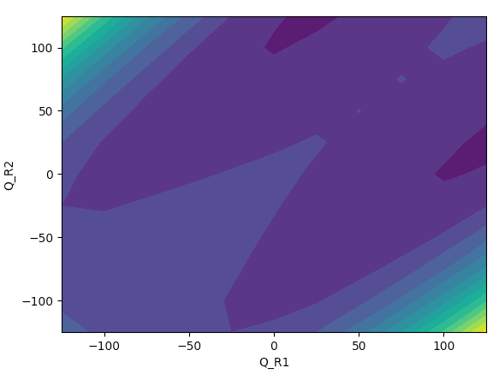
Protonated Anthracene Update
Plotting 2D energy surfaces – IRC rxnCoords
Plotting out the energy surface across the forward and reverse IRC coordinates shows the clear transition state saddle point and Csv minima on each side. Line of symmetry along the R1=R2 coordinate

Slide 5
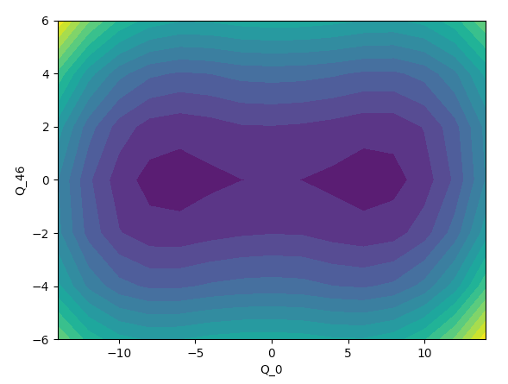
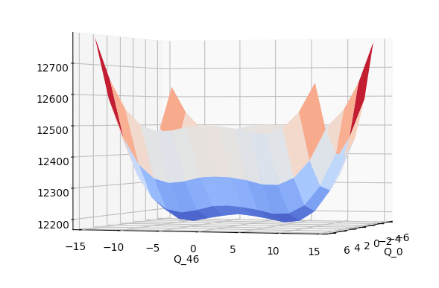
Protonated Anthracene Update
Plotting 2D energy surfaces – TS normal modes
Clear saddle point along imaginary freq coord v1 (b2)

Slide 6
Protonated Anthracene Update

Slide 7
Protonated Anthracene Update

